Slide 1
COMP 3067
Fundamentals of Information Visualisation (FIV)
Lecture 1:
Introduction & Value of Visualisation
Spring 2019

Slide 2
Module Information
Instruction Medium: English
  Instructor: Sheung Hung Poon
  Lecture Time: (2 hours)
  Monday: 9:00am - 11:00am (PMB 433)

Slide 3
Instructor’s Contacts
Instructor: Benedict Sheung Hung POON
    (You may simply call me “Ben”.)
  Email: Sheung-Hung.Poon@nottingham.edu.cn
  Office: PMB 424
  Office Hours: Monday 2pm – 4pm
  OR, simply drop by my office to discuss …
OR, send me email to make appointment …

Slide 4
Module Aims
Fundamental understanding on how visualizations convey information and how humans perceive
Master an essential set of visualization techniques
Practical experience in visualizing data and information

Slide 5
Textbooks
Textbook: (Primary)
  Information Visualisation: Perception for Design, 3rd Edition,
  by Colin Ware,
  Published by: Morgan Kaufmann in 2012
Secondary Textbook:
  Visualization Analysis and Design, 1st Edition,
  by Tamara Munzner,
  Published by: CRC Press in 2005

Slide 6
Teaching Materials
Lecture notes will be available on Moodle.
Additional reading materials:
  The Visual Display of Quantitative Information (2nd Edition). E. Tufte. Graphics Press, 2001
  R Graphics Cookbook, Winston Chang, O'Reilly Media, 2013 [you can ﬁnd it by searching it online].

Slide 7
Assessment Method
25% course work
75% written final examination

Slide 8
Module Content …
(subject to change …)
Introduction & Value of Visualisation
Data, Image & Data representation
Multivariate Data Visualisation
Visualisation Tools & Visual Perception
Interaction
Evaluating InfoVis
Text Visualisation
Vis doc & time-series data
Trees & Graphs

Slide 9
Module Summary
This module aims to cover the following:
A broad overview of the fundamental theories and techniques of Information Visualisation
Psychological theories that help explain how humans process information
Application and delivery mechanisms for visualisations of information
Scientific and creative approaches to construction visualisations
Important challenges such as representation of ambiguous or time-based data
Interaction methods to help people understand data

Slide 10
What is Visualisation ?

Slide 11

What is visualization?
visualize: (vb) to form mental
image or vision of..
visualize: (vb) to image or
remember as if actually seeing.
It is a cognitive activity –it goes on in the mind
The potential value of visualization – that of gaining insight and understanding

Slide 12

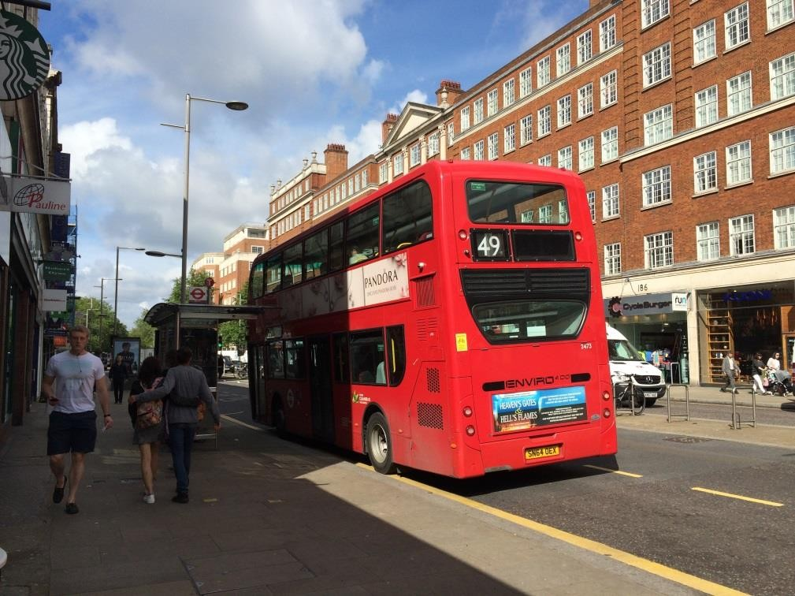


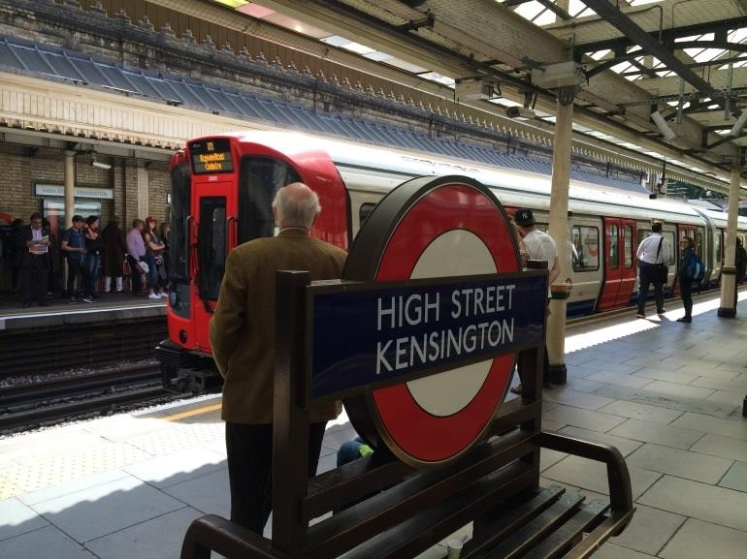
Information Visualisation Example 1

Slide 13
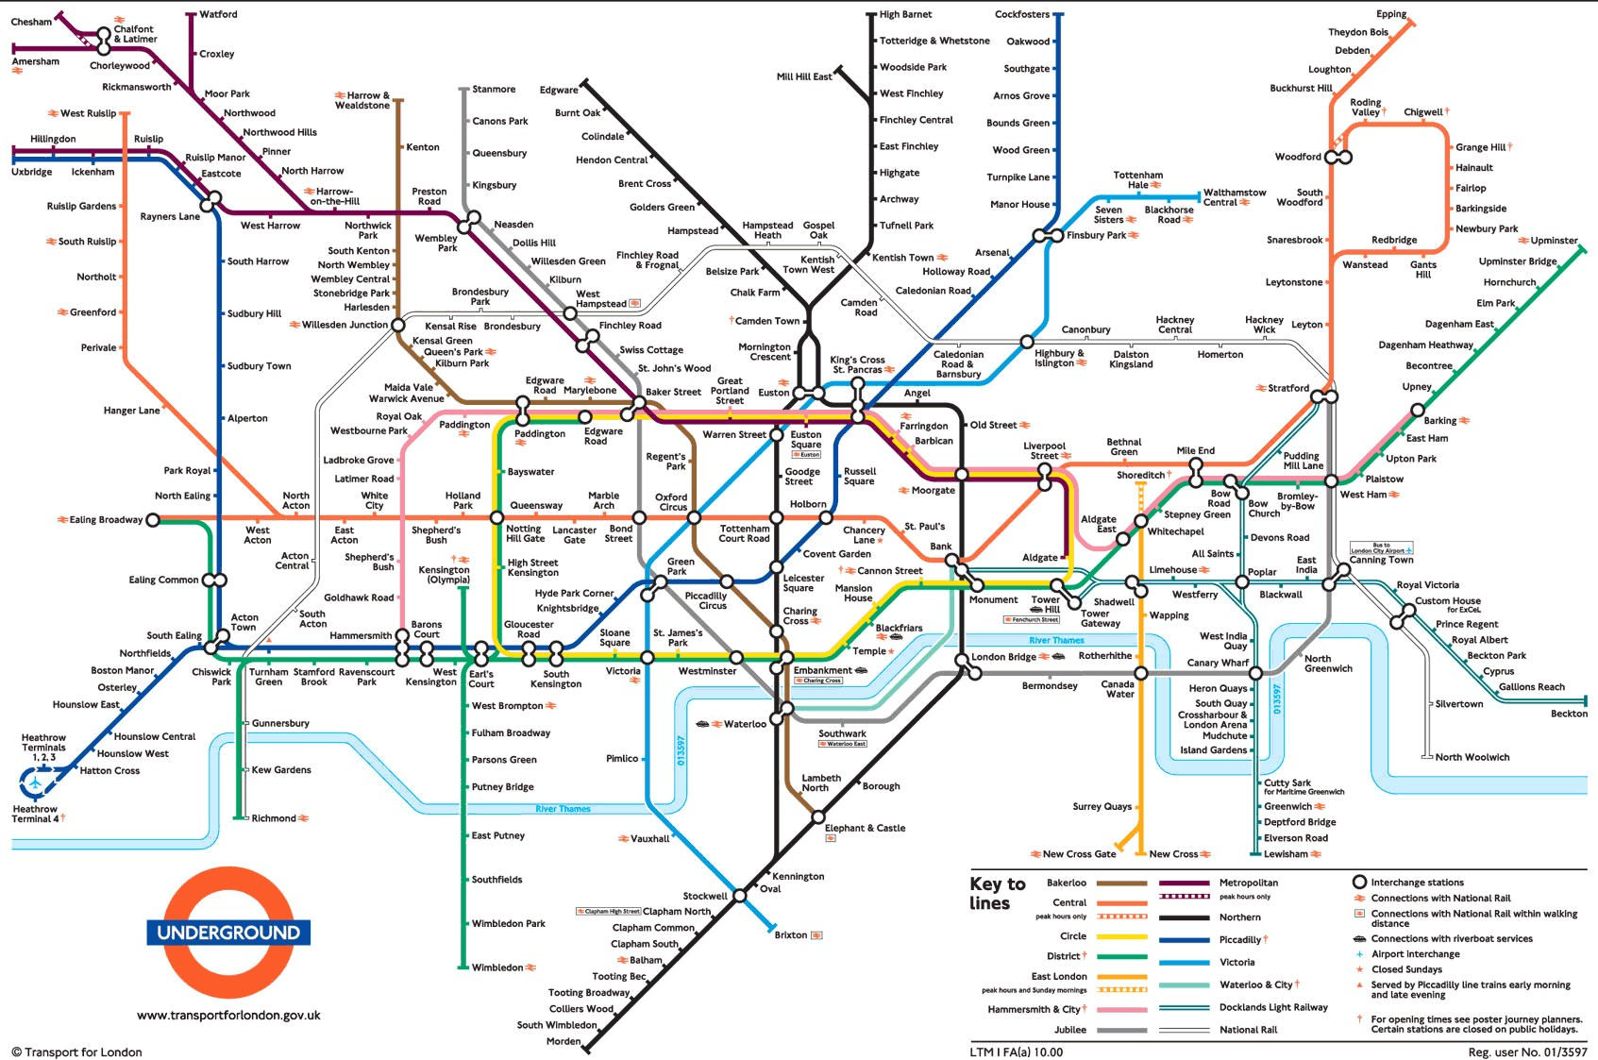

Slide 14
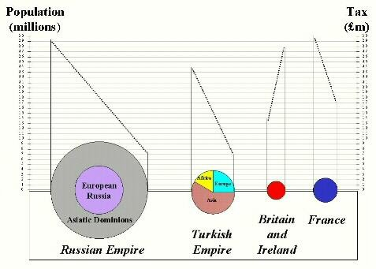
Information Visualisation Example 2

Slide 15
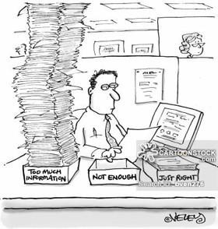
The Key Challenge
G53FIV
How to make use of the data
  How do we avoid being overwhelmed?
  How do we make sense of the data?
  How do we harness this data in decision-‐making processes?

Slide 16




G53FIV
Data → Useful Information
Transform the data into information (understanding, insight) thus making it useful
^{to people} Objective

Slide 17
What is Information Visualization?
G53FIV
Deﬁnitions
  “... ﬁnding the artiﬁcial memory that best supports our natural means of perception.” [Bertin 1967]
  “The use of computer-‐generated, interactive, visual representations of data to amplify cognition.” [Card, Mackinlay, & Shneiderman 1999]

Slide 18
Constituents
Two key aspects of infovis
  Representation
  Interaction (too often overlooked)
“The effectiveness of information visualization hinges on two things: its ability to clearly and accurately represent information and our ability to interact with it to figure out what the information means.”
S. Few, Now you see it

Slide 19
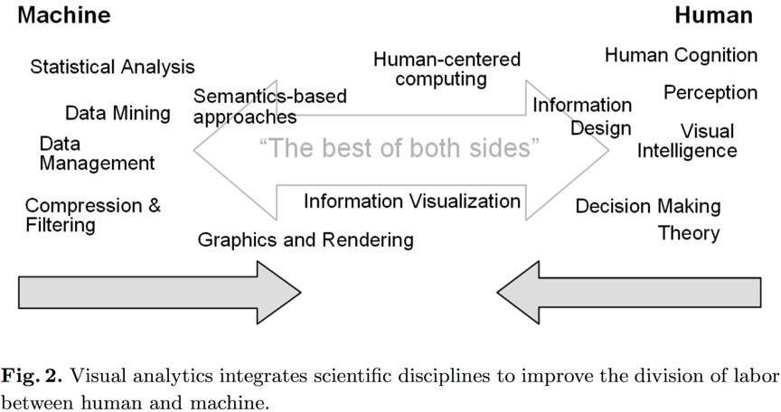
G53FIV
The Best of Both Sides

Slide 20
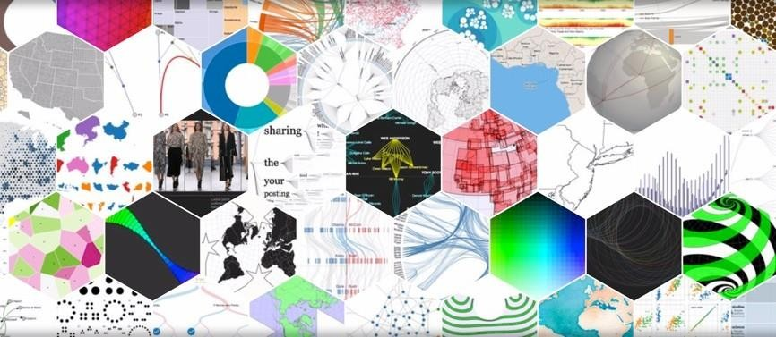
Information Visualization Examples
G53FIV
https://d3js.org/

Slide 21
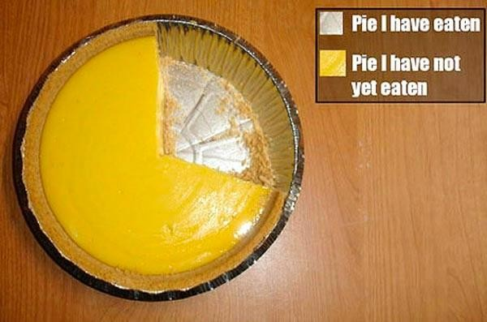
Pie Chart
G53FIV

Slide 22

D3’s Show Reel
G53FIV
Transitions between various visualization types
lines
horizons
areas
stacked areas
streamgraph
overlapping areas
grouped bars
stacked bars
bars
donut
https://bl.ocks.org/mbostock/1256572

Slide 23

G53FIV

Slide 24
Why Create Visualization?
G53FIV
Answer questions (or discover them)
Make decisions
See data in context
Expand memory
Support graphical calculation
Find patterns
Present argument or tell a story
Inspire

Slide 25



Why Create Visualization?
G53FIV
Answer questions (or discover them)
Make decisions
See data in context
Expand memory
Support graphical calculation
Find patterns
Present argument or tell a story
Inspire
Dr. Ke Zhou (http://www.cs.nott.ac.uk/~pszkz/)

Slide 26


Two Key Applications of InfoVis
G53FIV
I. Presentation (Communications)
  Communicate data and ideas
  Explain and inform
  Provide evidence and support
  Inﬂuence and persuade
II. Analysis (Reasoning)
  Explore the data
  Assess a situation
  Determine how to proceed
  Decide what to do
Courtesy to J. Stasko on the categorization and part of the slides (EuroVis’14).

Slide 27
Goals of “Presentation”
G53FIV
Show a few variables or subset of the data
Objectives
  Clarify
  Focus
  Highlight
  Simplify
  Persuade
Simply presenting data visually can have a profound impact!

Slide 28
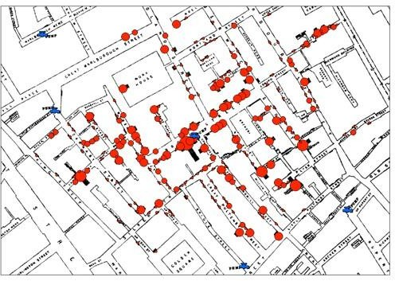
London Cholera Map
G53FIV
The closer to the Broad Street water pump, the greater the number of deaths.
The information helped convince the public a true sewage system was needed.
London Cholera Map
Visualization by John Snow, 1854.

Slide 29
Surprises in Data
G53FIV
“The greatest value of a picture is when it forces us to notice what we never expected to see.”
John Tukey, 1977
“Contained within the data of any investigation is information that can yield conclusions to questions not even originally asked. That is, there can be surprises in the data...”
W. Cleveland The Elements of Graphing Data

Slide 30
How Can We Assess the Value of InfoVis ?
G53FIV

Slide 31
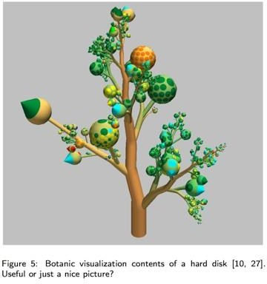
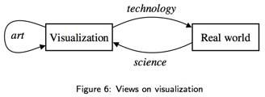
Evaluation is Not Easy
G53FIV
Especially for Exploratory Task
– Vagueness or absence of speciﬁc tasks
Usability vs. Aesthetics
The Value of Visualization. Jarke J. van Wijk. Visualization, 2005.

Slide 32
G53FIV
Assessing the Value of InfoVis
V = T + I + E + C
Stasko, John. "Value-‐driven evaluation of visualizations." Proceedings of the Fifth Workshop on Beyond Time and Errors: Novel Evaluation Methods for Visualization. ACM, 2014.

Slide 33
G53FIV
Assessing the Value of InfoVis
V = T + I + E + C
T = The ability to minimize total time needed to answer a wide variety of questions (without formal queries).

Slide 34
What Questions to Ask?
G53FIV
Low-level questions
  Retrieve value
  Filter
  Compute derived value
  Find extreme cases
  Sort
  Determine range
Characterize distribution
Find anomalies
Cluster
Correlate
Amar, Eagan & Stasko InfoVis ‘95

Slide 35
G53FIV
Assessing the Value of InfoVis
V = T + I + E + C
I = The ability to spur and discover insights or insightful questions about the data.

Slide 36
What is Insight?
G53FIV
An individual observation about the data by the participant, a unit of discovery
  Complex
  Deep
Qualitative
Relevant
Unexpected
Saraiya, et al. TVCG ‘05
Is knowledge-building and model-conﬁrmation
– Like a substance that people acquire with the aid of systems
Chang, et al. IEEE CG&A ‘09

Slide 37
G53FIV
Assessing the Value of InfoVis
V = T + I + E + C
E = Ability to convey an overall essence or take-‐away sense of the data.

Slide 38
G53FIV
Assessing the Value of InfoVis
V = T + I + E + C
C = Ability to generate conﬁdence and trust about your data given its domain and context.

Slide 39




Information Overload
G53FIV

Slide 40
Fundamental Problems
Scale – Many data sets are too large to visualise on one screen
Diversity – Data of data types, forms and sizes

Slide 41
Scale Solutions
Potential solutions for dealing with large-scale complex data:
  Representation: Interface mechanisms to allow users to work at views of a data set:
    Overview and details
    Zooming
    Focus and context
  Interaction
  Both

Slide 42
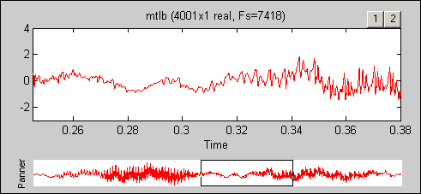
Overview+details
Simultaneously display both an overview and detailed view of an information space, combined either in time or space
  Time: Alternate between overview and details sequentially in the same place
  Space: Use different space of screen to show overview and details

Slide 43
Discussion
What are other examples of overview+detail interface?
What are the advantages?
What are the problems?

Slide 44
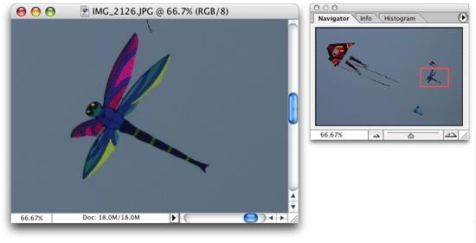
Discussion
What are other examples of overview+detail interface?
– Eg Photoshop
What are the advantages?
  Providing an overview of the data set can be extremely valuable
    Helps present overall patterns
    Assists user with navigation and search
    Orients activities
  Also allow user to find and focus on details of interest
What are the problems?
  Still not a true overview
  Clunky interaction
  The mental effort and time required to integrate the distinct views.

Slide 45
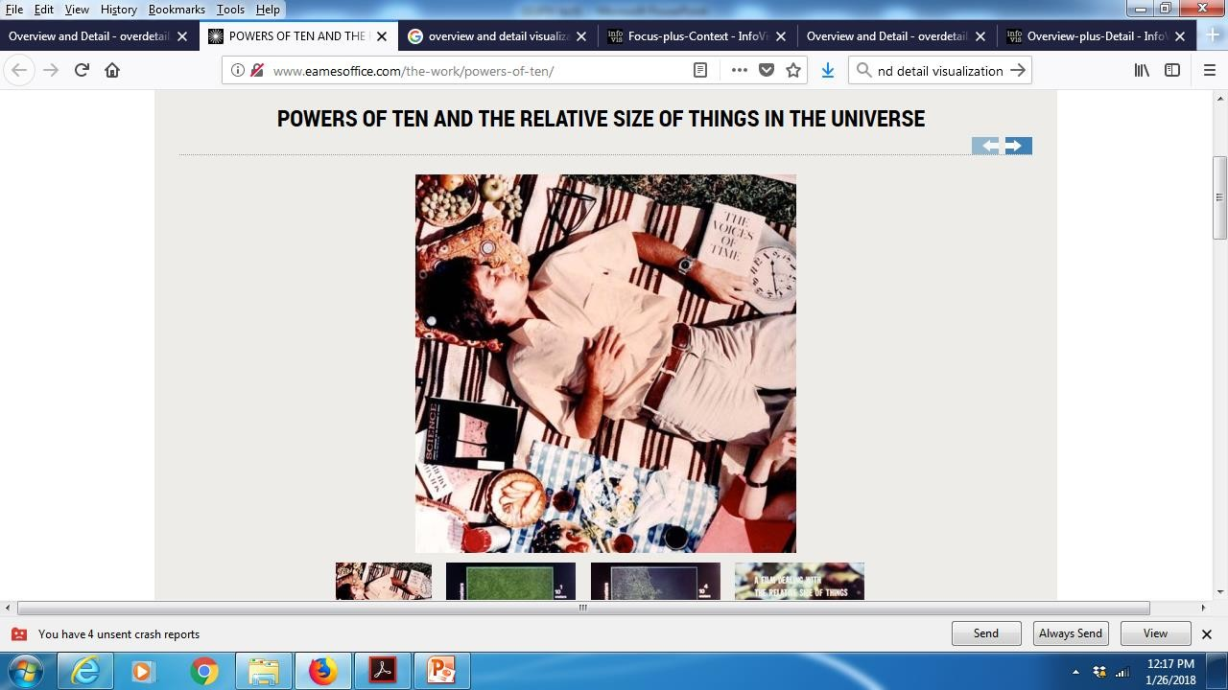
Zooming
Zoom out shows an overview of data space then zooming in allows viewer to examine details
Involves temporal separation between views Example: Watch a famous video - Powers of ten http://www.eamesoffice.com/the-work/powers-of-ten/

Slide 46
Focus+Context
To enable viewers to see the object of primary interest presented in full detail while at the same time getting a overview–impression of all the surrounding information — or context — available.
Same as Overview+details but with one key difference:
  Typically, the overview and the detail are combined into a
single display
  Mimics our natural vision systems more closely
  Minimizes the seam between views by displaying the focus within the context

Slide 47
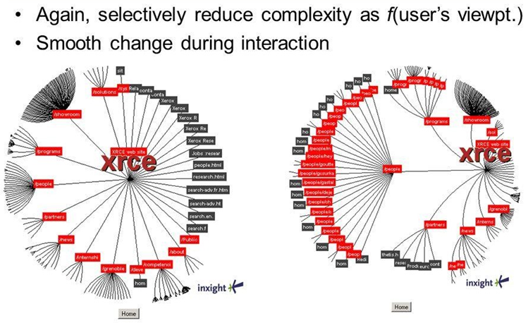
Focus+Context – Hyperbolic View

Slide 48
Additional Reading Material & Exercise
Read Module Week 1’s additional reading paper: A tour through the Visualisation Zoo on Moodle site.
Do Home Exercise 1: Making Logos with ILLUSTRATOR (see Moodle site for details)

